Slide 1
Term Project – Team 3 Spotify
Katrina Sutton, Rilov Kulankara, Sean Lin

Slide 2
Agenda
Objective
Data Overview
Data Preparation
Analysis
Conclusion

Slide 3
Objective
What do these top songs have in common?
Why do people like them?
Is there a way to predict popularity based on song attributes?

Slide 4
Data Overview
Spotify playlist of songs streamed most often over the course of the year
Data includes:
Artists & Song Names
Audio Features
Danceability, Energy, Key
Data source: Kaggle Spotify 2018 Songs
https://www.kaggle.com/akcayangelo/spotify-2018-analysis
Notes:
Original Data Source: The audio features for each song were extracted using the Spotify Web API and the spotipy Python library. Credit goes to Spotify for calculating the audio feature values.
Audiofeatures: danceabilityDanceability describes how suitable a track is for dancing based on a combination of musical elements including tempo, rhythm stability, beat strength, and overall regularity. A value of 0.0 is least danceable and 1.0 is most danceable.
energyEnergy is a measure from 0.0 to 1.0 and represents a perceptual measure of intensity and activity. Typically, energetic tracks feel fast, loud, and noisy. For example, death metal has high energy, while a Bach prelude scores low on the scale. Perceptual features contributing to this attribute include dynamic range, perceived loudness, timbre, onset rate, and general entropy.
keyThe key the track is in. Integers map to pitches using standard Pitch Class notation. E.g. 0 = C, 1 = C♯/D♭, 2 = D, and so on.
loudnessThe overall loudness of a track in decibels (dB). Loudness values are averaged across the entire track and are useful for comparing relative loudness of tracks. Loudness is the quality of a sound that is the primary psychological correlate of physical strength (amplitude). Values typical range between -60 and 0 db.
modeMode indicates the modality (major or minor) of a track, the type of scale from which its melodic content is derived. Major is represented by 1 and minor is 0.
speechinessSpeechiness detects the presence of spoken words in a track. The more exclusively speech-like the recording (e.g. talk show, audio book, poetry), the closer to 1.0 the attribute value. Values above 0.66 describe tracks that are probably made entirely of spoken words. Values between 0.33 and 0.66 describe tracks that may contain both music and speech, either in sections or layered, including such cases as rap music. Values below 0.33 most likely represent music and other non-speech-like tracks.
acousticnessA confidence measure from 0.0 to 1.0 of whether the track is acoustic. 1.0 represents high confidence the track is acoustic.
instrumentalnessPredicts whether a track contains no vocals. "Ooh" and "aah" sounds are treated as instrumental in this context. Rap or spoken word tracks are clearly "vocal". The closer the instrumentalness value is to 1.0, the greater likelihood the track contains no vocal content. Values above 0.5 are intended to represent instrumental tracks, but confidence is higher as the value approaches 1.0.
livenessDetects the presence of an audience in the recording. Higher liveness values represent an increased probability that the track was performed live. A value above 0.8 provides strong likelihood that the track is live.
valenceA measure from 0.0 to 1.0 describing the musical positiveness conveyed by a track. Tracks with high valence sound more positive (e.g. happy, cheerful, euphoric), while tracks with low valence sound more negative (e.g. sad, depressed, angry).
tempoThe overall estimated tempo of a track in beats per minute (BPM). In musical terminology, tempo is the speed or pace of a given piece and derives directly from the average beat duration.
duration_msThe duration of the track in milliseconds.
time_signatureAn estimated overall time signature of a track. The time signature (meter) is a notational convention to specify how many beats are in each bar (or measure).

Slide 5
Data Attributes – Metrics by Spotify
Danceability
Energy
Key
Loudness
Mode
Speechiness
Acousticness
Instrumentalness
Liveness
Valence
Tempo
Time - Duration

Slide 6
Data Preparation
Strong Structured Dataset
Removed categorical attributes such as Artists & Song Name
No missing or null values that needed to be addressed or manipulated
Data formatted in .csv, imported into notebook
Notes:
Due to no correlation between non-numerical data

Slide 7
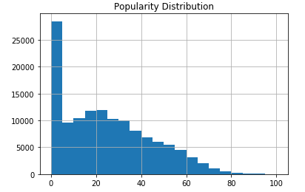
Data Preparation
Popularity is given as an integer from 0-100 that measures how popular a song is
Defined “popular” song to be one with a popularity value >60 (~top 5% of all songs)

Slide 8
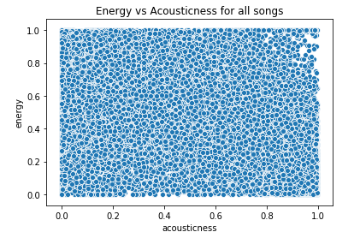
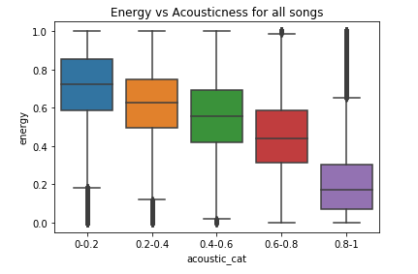
Data Preparation
Many attributes were given as continuous parameters ranging from 0-1
Binned most of the attributes to facilitate visualization and analysis

Slide 9
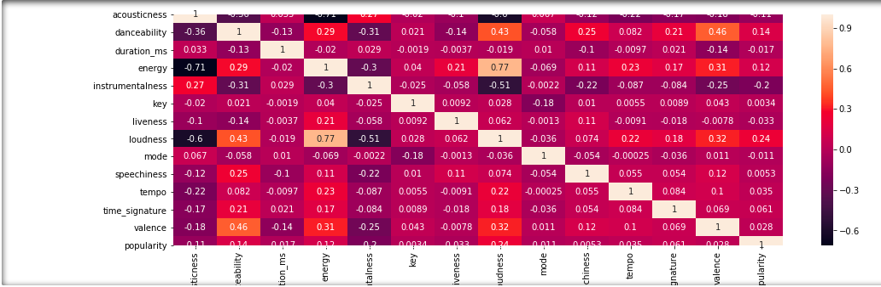
Data Analysis – Why Do People Like Them
Notes:
Based on the analysis there is meadium/weak correlation for following attributes has some kind of slight leanerar relations ship
danceability 0.144925 energy 0.117922 instrumentalness -0.204741 loudness 0.235315

Slide 10
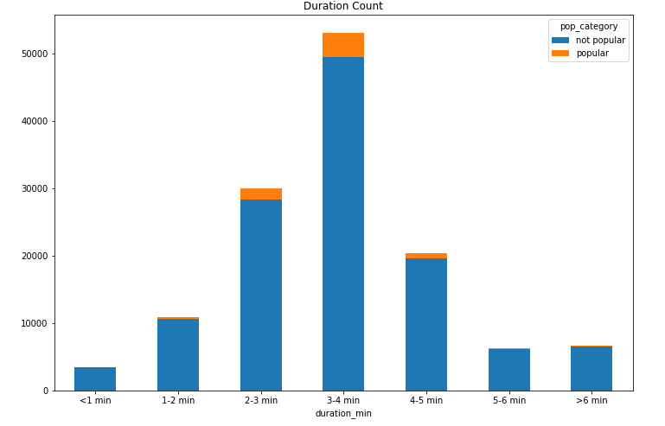
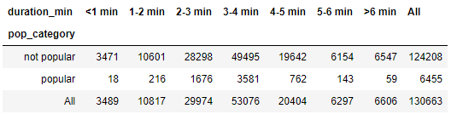
Data Analysis - Duration
Approx. normally distributed
3-4 min songs are most common, and have the highest number of popular songs as well

Slide 11
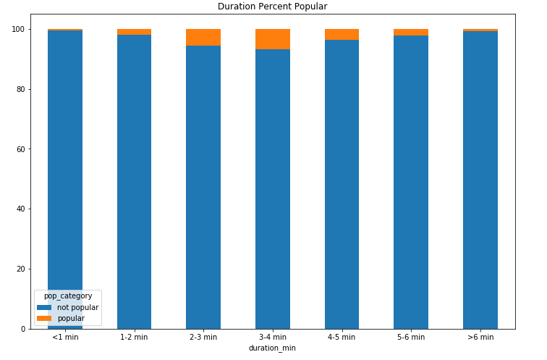
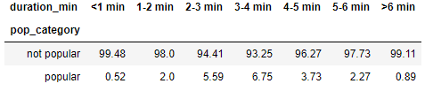
Data Analysis - Duration
Normalized to obtain proportion of popular vs non-popular songs for each respective duration category
3-4 min songs have the highest ratio of popular songs
Extremely short/long tracks have very low popularity

Slide 12
Data Analysis - Loudness
Waveforms from Foobar2000, loudness measurements from Adobe Audition
Refers to loudness units relative to full scale (LUFS)
dB scale with 0 being loudest
Average measure of how loud a song is
Imagine Dragons – Radioactive: -5.31 LUFS
Radwimps – Sparkle: -9.40 LUFS
Explosions in the Sky – First Breath After Coma: -14.26 LUFS
Bach – Aria from Goldberg Variations: -25.67 LUFS

Slide 13
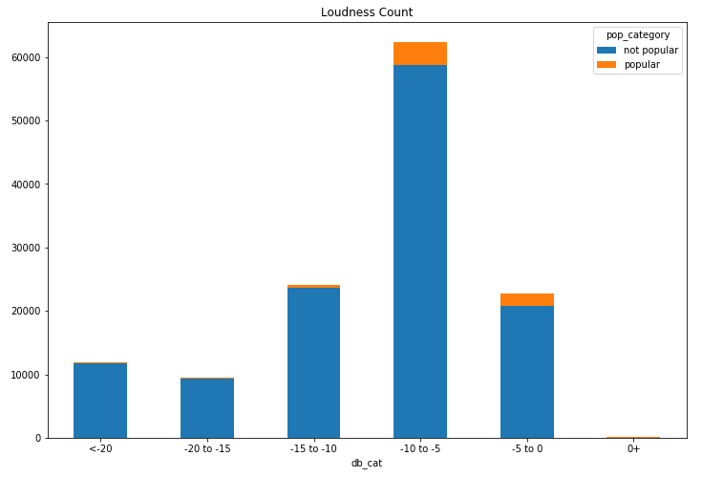
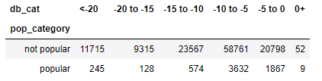
Data Analysis - Loudness
Most songs are between -10 and -5 dB in loudness
Artists prefer to produce songs with some dynamic range
A handful of songs were mastered to louder than 0 dB
Lots of clipping

Slide 14
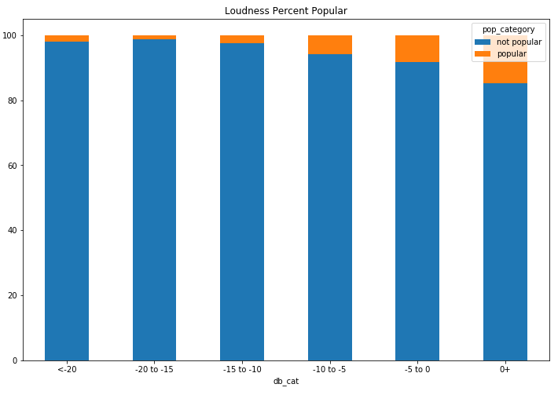
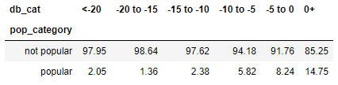
Data Analysis - Loudness
Of the categories with large sample sizes, -5 to 0 dB songs are most frequently popular
Generally, louder is much more popular

Slide 15
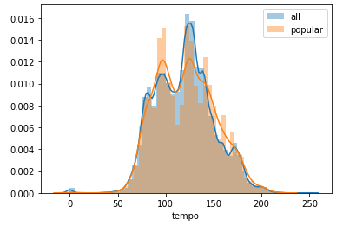
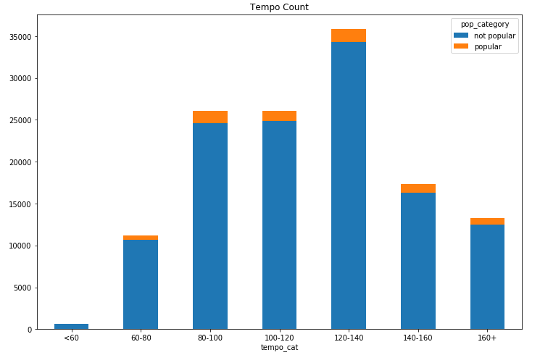
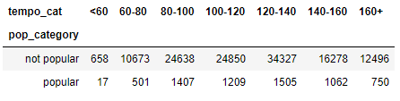
Data Analysis - Tempo
120-140 bpm songs are most common, but 80-100 bpm appear to have higher popularity rate based on histogram

Slide 16
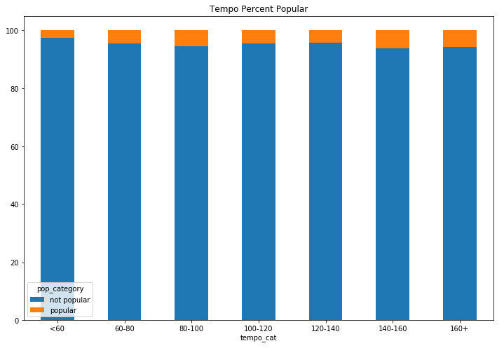
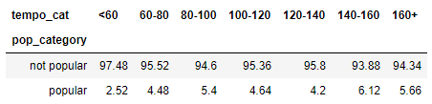
Data Analysis - Tempo
Normalized, 140-160 bpm range has highest rate of popular songs, but generally all songs over 60 bpm are fairly close in distribution

Slide 17
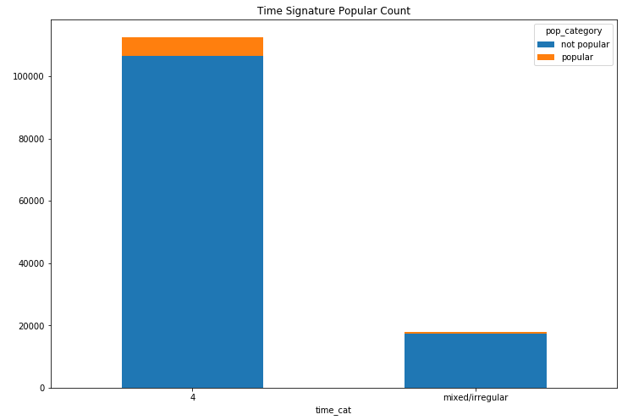
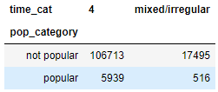
Data Analysis – Time Signature
Categorized songs as either 4/4 time or other (1, 2, 3 and 5)
Spotify does not appear to detect songs with changing time sig, or other odd meters)
As expected, 4/4 is most common

Slide 18
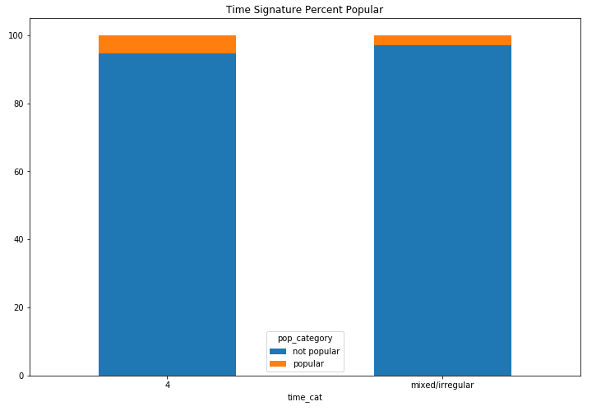
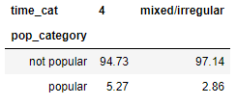
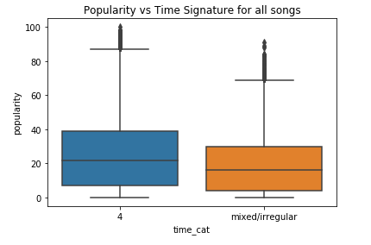
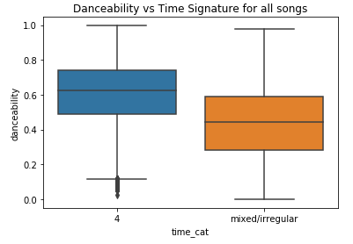
Data Analysis – Time Signature
4/4 time popular rate is close to the population rate
Non-4/4 songs have much lower popular rate
4/4 has higher danceability

Slide 19
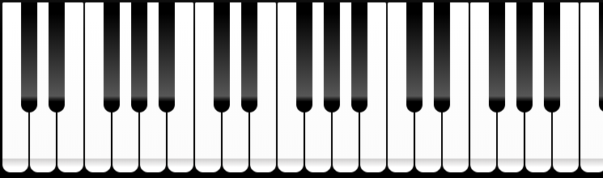
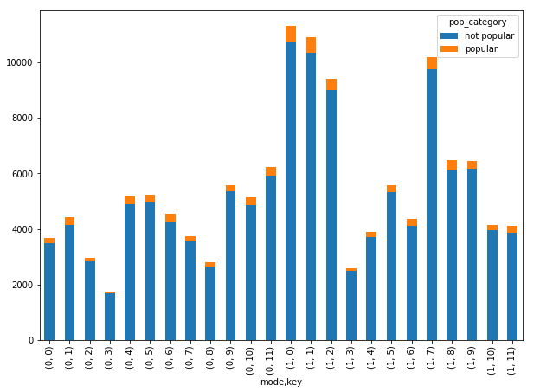
Data Analysis – Tonality
Mode refers to major (1) or minor (0)
12 notes of octave are notated by 0-11, with C being 0
24 possible combinations
(mode, key)
e.g. (1,0) would be C major
Major keys are most common
C, C#/Db, G, and D major most common keys

Slide 20
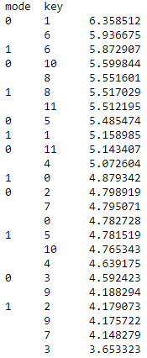
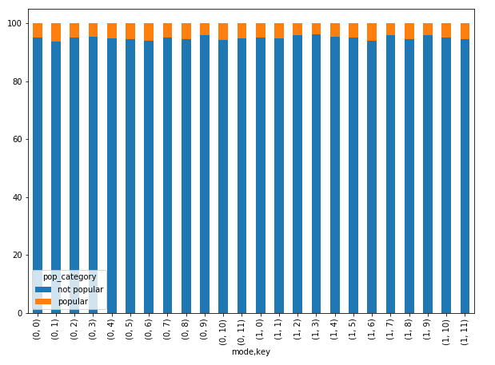
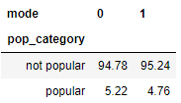
Data Analysis – Tonality
C# minor is most popular, Eb major least popular
Overall difference between major/minor is small

Slide 21
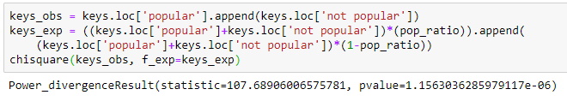

Data Analysis – Tonality
Chi-squared test:
$X^{2}=\sum_{i=1}^{k}{\frac{{\left(x_{i}−m_{i}\right)}^{2}}{m_{i}}}$
$x$ = observed frequency, m = expected frequency
Null hypothesis - if popular songs are randomly distributed among all 24 keys, each key will have about the same as the global population rate of popular songs (4.94%)
Chi-squared test shows that there is a 1.16x10⁻⁶ chance this is the case

Slide 22
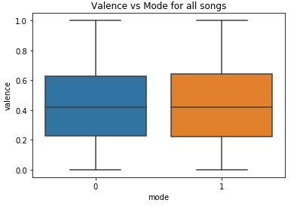
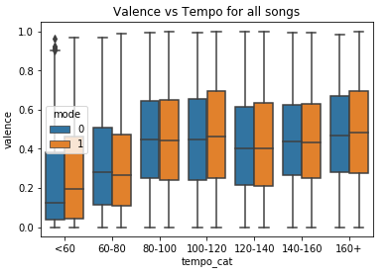
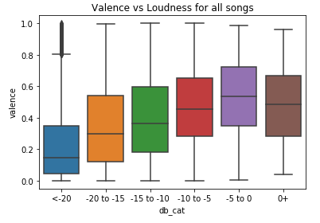
Data Analysis – Tonality
No relation between valence (happy/sad) and mode
Minor songs are not automatically sad
Valence has much more to do with tempo/energy/dB level

Slide 23
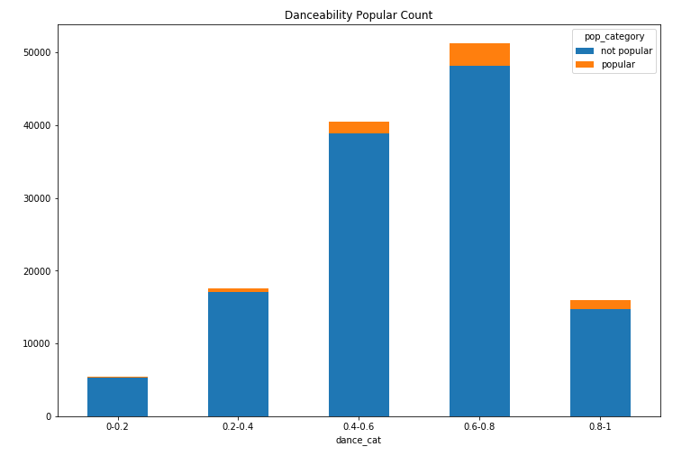
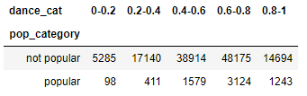
Data Analysis - Danceability
Suitability for dancing
Tempo, rhythmic stability, beat strength, overall regularity
Medium-high danceability songs more common
Sharp drop-off for very high danceability songs

Slide 24
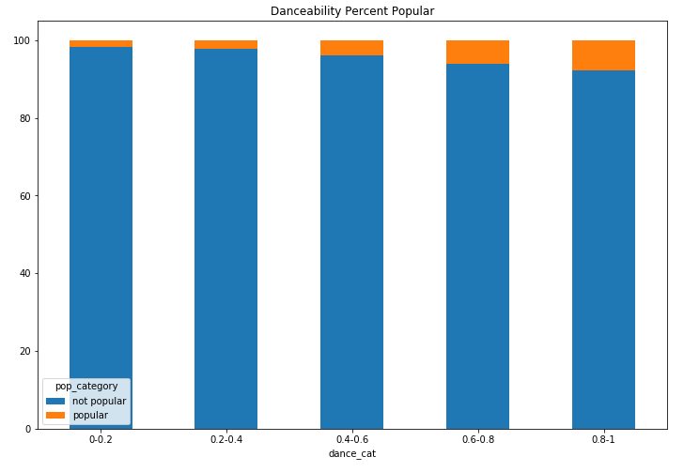
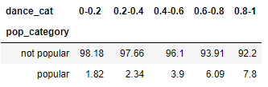
Data Analysis - Danceability
Overall increasing trend with highly danceable songs being most popular
People like dancing
Songs that are easy to dance to tend to get more plays

Slide 25
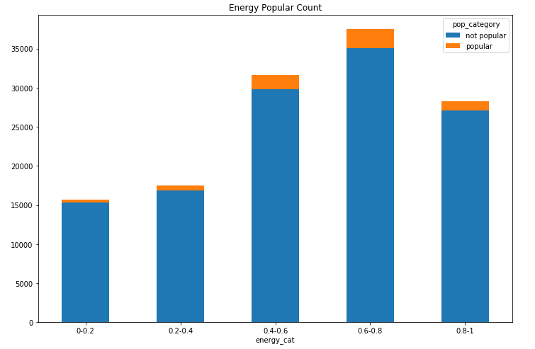
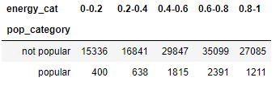
Data Analysis - Energy
Perceptual measure of intensity and activity
High energy = fast, loud, noisy
More energetic songs are more common

Slide 26
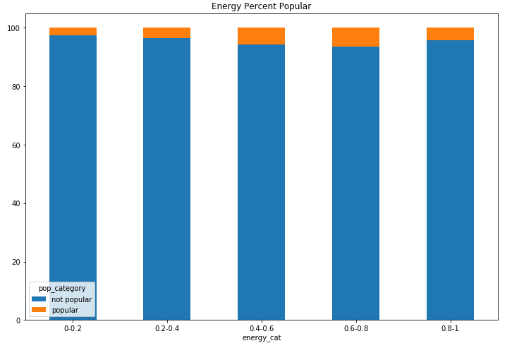
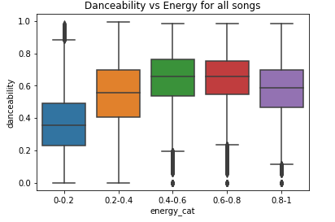
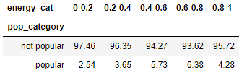
Data Analysis - Energy
Very high energy songs are less popular than medium-medium high ones
Possibly due to slight drop in danceability?
Indicator that people enjoy songs with varying dynamics (e.g. build-up and drop), rather than one that’s constantly hard-hitting

Slide 27
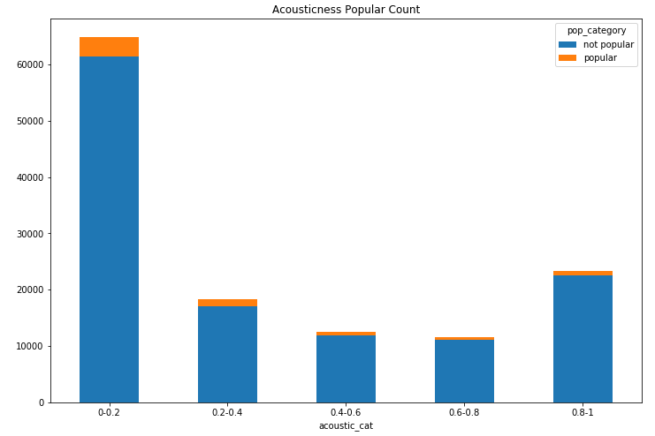
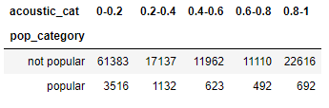
Data Analysis – Acousticness
Confidence measure of whether the song is acoustic
Most songs have low acousticness (most pop genres, electronic music etc.)
Increase of high acousticness songs likely due to classical and jazz

Slide 28
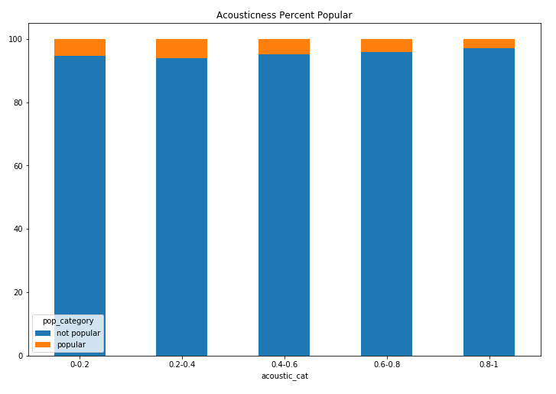
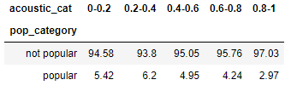
Data Analysis – Acousticness
0.2-0.4 most popular, 0.8-1 notably unpopular
Purely acoustic music tends to get less plays

Slide 29
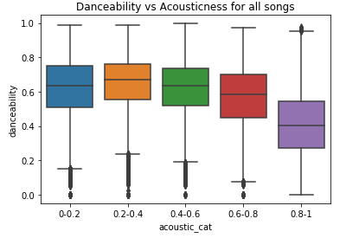
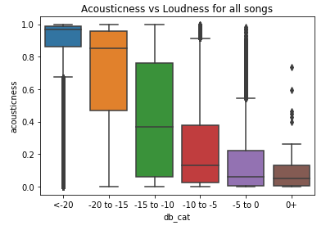
Data Analysis – Acousticness
Generally higher danceability with low/med-low acousticness
Loud music generally low in acousticness
People like dancing and loud music
People don’t like high acousticness

Slide 30
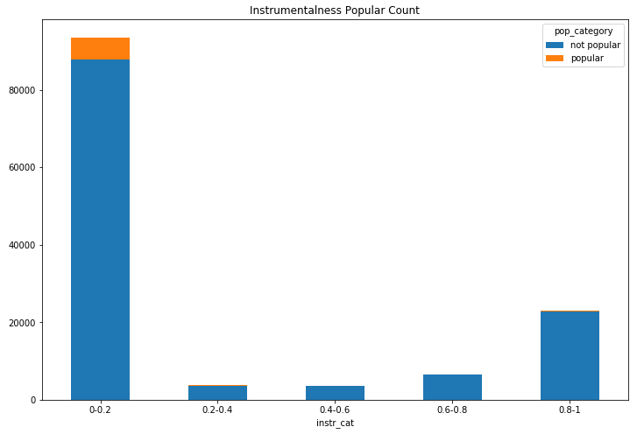
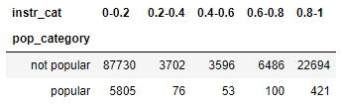
Data Analysis - Instrumentalness
Prediction of a track having no vocals
Not necessarily how much vocals a song contains
Zero instrumentalness accounts for vast majority of songs
High instrumentalness also relatively common

Slide 31
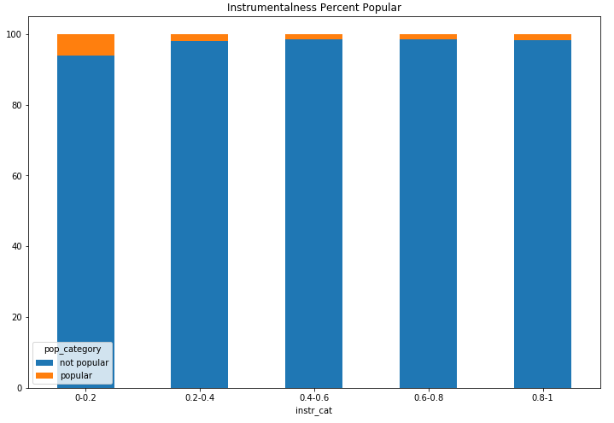

Data Analysis - Instrumentalness
Low instrumentalness more than 3x more likely to contain a popular song
People like songs with vocals/lyrics

Slide 32


Data Analysis - Instrumentalness
Low instrumentalness songs tend to be produced much louder
Louder songs predominantly do contain vocals
If people like loud music, they will gravitate to music that have vocals
Or, if people like singing, they will tend to listen to more loud music

Slide 33
Data Analysis – What attributes do popular songs tend to have?
Louder and highly danceable, usually meaning:
not too slow (faster than 60 bpm)
in 4/4 time
high but not excessive energy level
Contains acoustic elements, but not entirely acoustic
Contains vocals
Medium length (3-4 min)

Slide 34
Data Analysis - Is there a way to predict popularity based on song attributes?
Leveraged Machine Learning to test data predictability for popularity
Defined attributes popular songs have in common
Grouped Dataset into Popular vs. Non-Popular songs
Define 80% of dataframe for testing and 20% for training
Conclusion
We are not able to predict accuracy using generated model
AUC is about 50%
In order to make accurate prediction we would need to train the model with a larger dataset

Slide 35
Conclusion
Popular songs do share some common attributes
People like them because:
3 -4 minutes in length
Contain vocals
Loud
Better danceability
Not too slow
Good energy and vibes
We can’t accurately predict popularity based on current dataset but could use machine learning if more data was available

